Slide 1
Chapter 2 Number Systems and codes (数系与编码)
Digital Logic Design and Application (数字逻辑设计及应用)
Numeric Data－ Number Systems and their Conversions
（数值信息 —— 数制及其转换）
Nonnumeric Data－ Codes
（非数值信息 —— 编码）

Slide 2
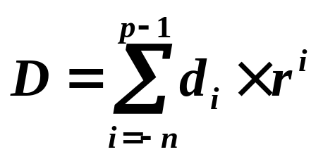
Review of Chapter 2 (第二章内容回顾)
Digital Logic Design and Application (数字逻辑设计及应用)
Positional Number System
(按位计数制)
  Binary, Octal, and Hexadecimal Numbers (二进制、八进制、十六进制)

Slide 3
Review of Chapter 2 (第二章内容回顾)
Digital Logic Design and Application (数字逻辑设计及应用)
General Positional-Number-System Conversion
(常用按位计数制的转换)
  A Number in any Radix to Radix 10 : Expanding the formula using radix-10 arithmetic
  (任意进制数 ⇒ 十进制数：利用位权展开)

Slide 4
Review of Chapter 2 (第二章内容回顾)
Digital Logic Design and Application (数字逻辑设计及应用)
General Positional-Number-System Conversion
(常用按位计数制的转换)
  A Number in Radix 10 to any Radix : Radix Multiplication or Division
  (十进制 ⇒ 其它进制：基数乘除法)
  Note: Decimal Fraction Parts Conversion
  [ 注意：小数部分的转换（误差）]

Slide 5
Review of Chapter 2 (第二章内容回顾)
Digital Logic Design and Application (数字逻辑设计及应用)
Addition and Subtraction of Nondecimal Numbers
(非十进制的加法和减法) （Table 2-3)
  进位输入 Cin 、进位输出 Cout 、 本位和 S
  借位输入 Bin 、借位输出 Bout 、 本位差 D

Slide 6
Review of Chapter 2 (第二章内容回顾)
Digital Logic Design and Application (数字逻辑设计及应用)
Representation of Negative Numbers
(负数的表示)
  Signed-Magnitude [ 符号－数值（原码）]
  Complement Number Systems (补码数制)
Radix – Complement (基数补码)
Diminished Radix – Complement
[ 基数减1补码（基数反码）]

Slide 7
Review of Chapter 2 (第二章内容回顾)
Digital Logic Design and Application (数字逻辑设计及应用)
Binary Signed-Magnitude, Ones’ – Complement, and Two’s – Complement Representation
(二进制的原码、反码、补码)
  正数的原码、反码、补码表示相同
  负数的原码表示：符号位为 1
  负数的反码表示：
    符号位不变，其余在原码基础上按位取反
    在 |D| 的原码基础上按位取反（包括符号位）
  负数的补码表示：反码 + 1

Slide 8
2.5.4 Two’s – Complement Representation
(二进制补码表示法)
Digital Logic Design and Application (数字逻辑设计及应用)
An n-bit Two’s- Complement range is
  (n位二进制补码表示范围)：
  – 2 ^{n-1} ~ + ( 2 ^{n-1} – 1)
  Only one representations of Zero
  ( 零只有一种表示 )
  Obtain a Two’s- Complement
  ( 二进制补码的求取 )：
  Ones’ – Complement (反码) + 1 （为什么？？）
  Expanding the Sign Bit ( 符号位扩展 )

Slide 9
2.5 Representation of Negative Numbers (负数的表示)
Digital Logic Design and Application (数字逻辑设计及应用)
Example 2.5.2：Write the 8-bit signed-magnitude, two’s-complement for each of these binary numbers.
(分别写出下面二进制数的8位符号–数值码、补码)
( – 1101 )2
( – 0 . 1101 )2

Slide 10
2.5 Representation of Negative Numbers (负数的表示)
Digital Logic Design and Application (数字逻辑设计及应用)
1、( – 1101 )₂
2、( – 0 . 1101 )₂
1、5位二进制表示：
原码 反码 补码
1 1101 1 0010 1 0011
[ [ D ]_{反} ]_{反} = D
[ [ D ]_{补} ]_{补} = D
2、8位二进制表示：
原码 反码 补码
1000 1101 1111 0010 1111 0011

Slide 11
2.6 Two’s – Complement Addition and Subtraction (二进制补码的加法和减法)
Digital Logic Design and Application (数字逻辑设计及应用)
Addition Rules: Added by ordinary binary addition (加法：按普通二进制加法相加)P.39
Subtraction Rules: Taking its two’s complement, then add
(减法：将减数求补，再相加) P.42

Slide 12
2.6 Two’s – Complement Addition and Subtraction (二进制补码的加法和减法)
Digital Logic Design and Application (数字逻辑设计及应用)
＋2 0010 －3 1101
＋ ＋5 ＋ 0101 ＋ －5 ＋ 1011
＋7 0111 －8 11000
＋7 0111 ＋1 0001
＋ －4 ＋ 1100 ＋ －6 ＋ 1010
＋3 10011 －5 1011

Slide 13
2.6 Two’s – Complement Addition and Subtraction (二进制补码的加法和减法)
Digital Logic Design and Application (数字逻辑设计及应用)
Overflow（溢出）
如果加法运算产生的和超出了数制表示的范围，则结果发生了溢出（Overflow）。
  对于二进制补码，加数的符号相同，和的符号与加数的符号不同。（C _{in} 与 C _{out} 不同） P.41
  对于无符号二进制数，若最高有效位上发生进位或借位，就指示结果超出范围。
  －5 1011 ＋7 0111
  ＋ －6 ＋ 1010 ＋ ＋3 ＋ 0011
  －11 10101 ＝ ＋5 ＋10 1010 ＝ －6

Slide 14
Digital Logic Design and Application (数字逻辑设计及应用)
0000
1111
0001
4位二进制补码
1110
0010
−1
+0
+1
−2
+2
0011
1101
−3
+3
1100
−4
+4
0100
−5
+5
1011
−6
+6
0101
−7
−8
+7
1010
0110
1001
0111
1000

Slide 15
Digital Logic Design and Application (数字逻辑设计及应用)
0000
4位无符号二进制数
1111
0001
1110
0010
15
0
1
14
2
0011
1101
13
3
1100
12
4
0100
11
5
1011
10
0101
6
9
8
7
1010
0110
1001
0111
1000

Slide 16
2.10 Binary Codes for Decimal Numbers
(十进制数的二进制编码)
Digital Logic Design and Application (数字逻辑设计及应用)
A set of n-bit strings in which different bit strings
Represent different numbers or other things.
(用于表示不同数或其它事件的一组n位二进制码的集合)

Slide 17
2.10 Binary Codes for Decimal Numbers
(十进制数的二进制编码)
Digital Logic Design and Application (数字逻辑设计及应用)
How to represent a 1-bit Decimal number with a 4-bit Binary code
(如何用 4位二进制码 表示 1位十进制码)？
  —— Binary Coded Decimal (BCD码）

Slide 18
2.10 Binary Codes for Decimal Numbers
(十进制数的二进制编码)
Digital Logic Design and Application (数字逻辑设计及应用)
How to represent a Negative BCD number
(负的BCD数如何表示)？
  Signed-Magnitude Representation: Encoding of the sign bit is arbitrary
  (符号－数值表示：符号位的编码任意)
  10’s-complement: 0000 indicates plus, 1001 indicates minus.
  (十进制补码表示：0000正，1001负)
Addition of BCD Digits (BCD数的加法) P.50

Slide 19
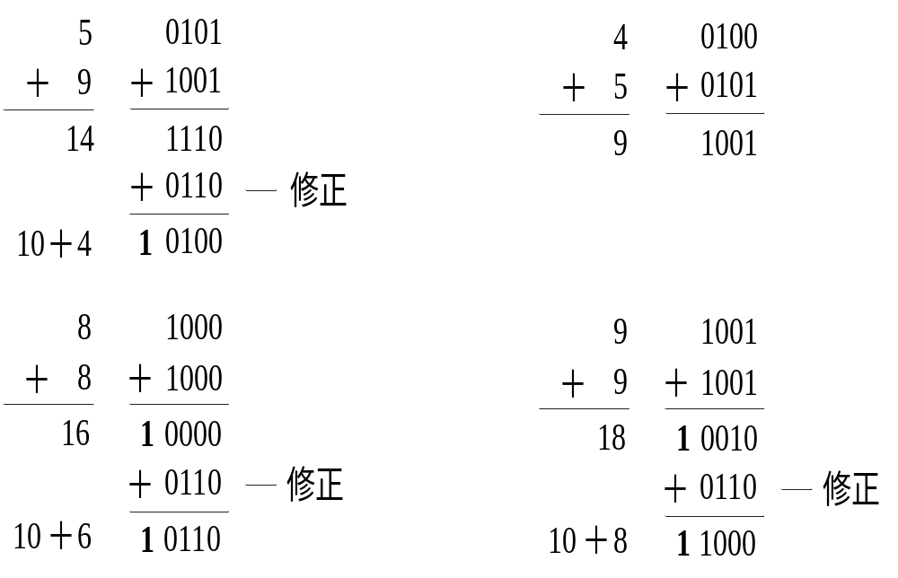
Digital Logic Design and Application (数字逻辑设计及应用)

Slide 20
2.10 Binary Codes for Decimal Numbers
(十进制数的二进制编码) (Table 2-9)
Digital Logic Design and Application (数字逻辑设计及应用)
BCD Code
2421 Code
Excess-3
(余3码)
Biquinary Code (二五混合码)
1-out-of-10 (10中取1码)
Weighted Code (加权码)
Self-Complement Code自反码

Slide 21
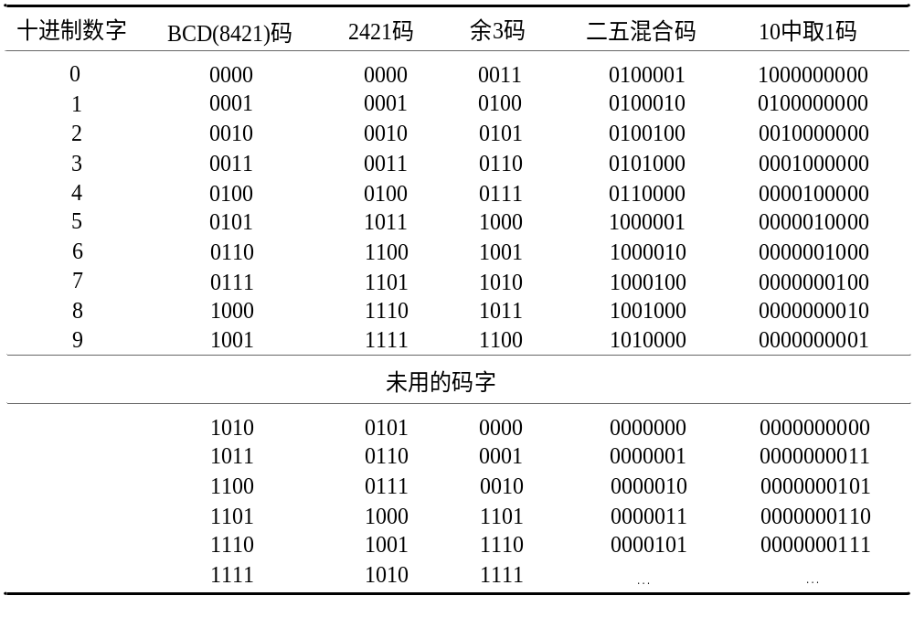
Digital Logic Design and Application (数字逻辑设计及应用)

Slide 22
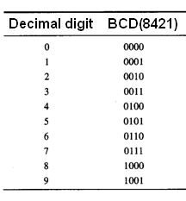
BCD codes
8421 code
Natural code , just like 4-bit binary numbers;
Each digit is weighted;
It has 10 valid code words and 6 invalid code words.

Slide 23
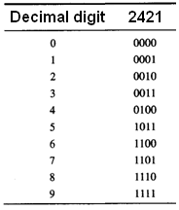
BCD codes
2421 codes
Each digit is weighted;
Self-complementing;
Use MSB to express
higher/lower part;
It has 10 valid codes and
6 invalid codes.

Slide 24
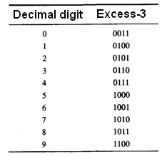
BCD codes
Excess-3 code
Its digit is not weighted;
Self-complementing ;
8421 code + “0011” .

Slide 25
BCD codes
Examples:
use BCD code for decimal numbers A = 1946
8421 code : A = 0001 1001 0100 0110
2421 code : A = 0001 1111 0100 1100
Excess-3 code: A = 0100 1100 0111 1001

Slide 26
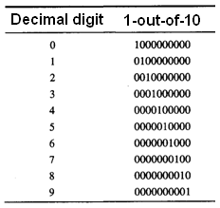
One hot codes
1-out-of-10 code
One hot code:
It is very useful in control systems.

Slide 27
Two hot codes
Biquinary code
7-bits; two hot code;
First 2 bits is one hot code for higher/lower range;
Last 5 bits is one hot code in the range.
Error-detecting property !

Slide 28
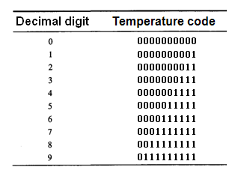
Temperature code
From one code to its neighbor, only one bit changed, no transition state.

Slide 29
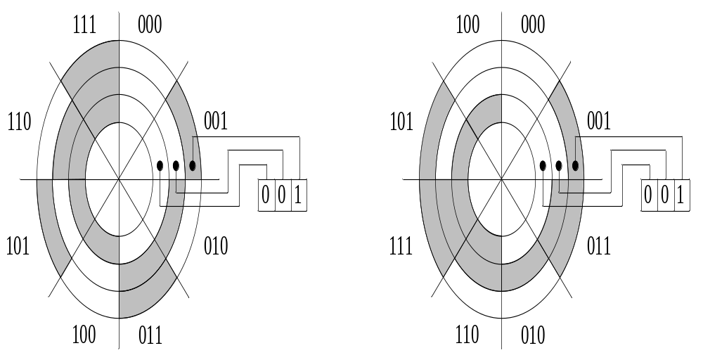
2.11 Gray code（格雷码）
Digital Logic Design and Application (数字逻辑设计及应用)

Slide 30
2.11 Gray code（格雷码）
Digital Logic Design and Application (数字逻辑设计及应用)
特点：
任意相邻码字间只有一位数位变化
最高位的0和1只改变一次
最大数回到0也只有一位码元不同

Slide 31
2.11 Gray code（格雷码）
Digital Logic Design and Application (数字逻辑设计及应用)
构造方法
  直接构造
  The bits of an n-bit binary cord word are numbered from right to left, from 0 to n-1.
  [对 n 位二进制的码字从右到左编号（0 ~ n-1）]
  Bit i of a Gray-code code word is 0 if bits i and i+1 of the corresponding binary code word are the same, else bit i is 1.
  (若二进制码字的第 i 位和第 i + 1 位相同，则对应的葛莱码码字的第 i 位为0，否则为1。)
  Reflected Code（反射码）

Slide 32
Gray codes
Target: code for continues changed numbers (in binary system) to prevent wrong code happened in transition time;
Property : In each pair of successive code words, only one bit changes.

Slide 33
Gray codes
From binary number to Gray code
The width is same, the MSB is same;
From left to right, if a bit in binary number is same as its left bit, the gray code is 0, if it is different, the gray code is 1.
Examples:
binary number: 1001 0010 0110 0011
Gray codes: 1101 1011 0101 0010

Slide 34
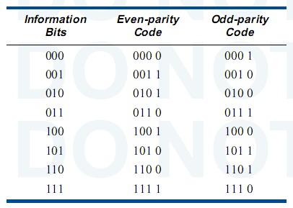
Error-detecting code
Information word + checking bit

Slide 35
Codes transmit way in digital circuit
Parallel way
use n-line to transmit an n-bits code words ;
transmit an n-bits code words in one time period;
Serial way
use one line to transmit an n-bits code words ;
transmit an n-bits code words in n time period;

Slide 36
Digital Logic Design and Application (数字逻辑设计及应用)
2.12 Character Codes (字符编码)
ASCII码（P36 表2-11）
2.13 Codes for Actions, Conditions, and States
(动作、条件和状态的编码)
使用 b 位二进制编码来表示 n 个不同状态
2.16 Codes for Serial Data Transmission and Storage
(用于串行数据传输与存储的编码)

Slide 37
第2章作业（P75～78）
Digital Logic Design and Application (数字逻辑设计及应用)
2.12 (b) (c)
2.22(选做)
2.26 (选做)
2.30 (选做)
2.35

Slide 38
Digital Logic Design and Application (数字逻辑设计及应用)
Chapter 3 Digital Circuits (数字电路)
Give a knowledge of the Electrical aspects of Digital Circuits
(介绍数字电路中的电气知识)

Slide 39
Consider some Questions
(思考几个问题)
Digital Logic Design and Application (数字逻辑设计及应用)
在模拟的世界中如何表征数字系统？
如何将物理上的实际值
映射为逻辑上的 0 和 1 ？
什么时候考虑器件的逻辑功能；
什么时候考虑器件的模拟特性？

Slide 40
A Class Problem ( 每课一题 )
Digital Logic Design and Application (数字逻辑设计及应用)
Indicate whether or not overflow occurs when adding the following 8-bit two’s-complement numbers:
1101 0100
+ 1010 1011
0010 0110
+ 0101 1010

